Slide 1
CovMo NT
GT Internal Training
2016 Nov

Slide 2
Question
Why we need NT data
What’s NT ?
What propose we using NT in CovMo
How important for correct NT data ?
Which module need NT data?

Slide 3
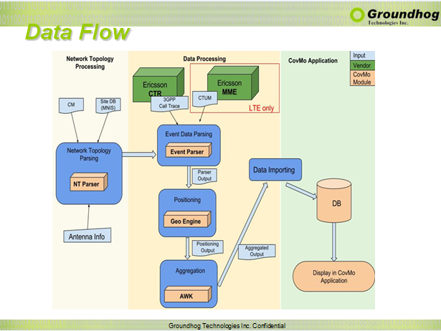

Slide 4
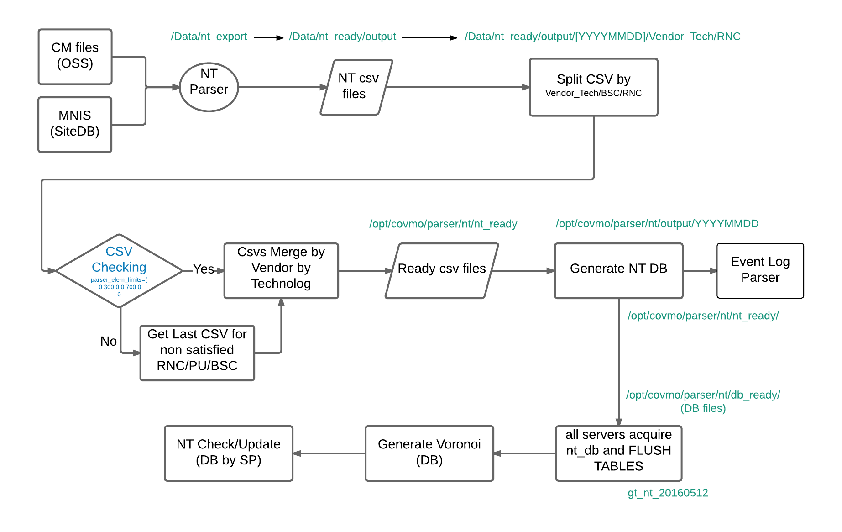
NT Process Steps
不同project供的資料
完成ntdb後會給event parser 用
為了要把編碼的資料解碼
確認csv是否完整
若不完整拿上 版的補
每個基站之間的分布 距離關係 可以知道密度

Slide 5
GT NT Definition document
Schema of Product
\\ghtdb02\project3\CovMo\CovMo_NT
Schema and definition
\\ghtdb02\project3\
FET, Etisalat, Vittel, STC, …
\\ghtdb02\project3\SingTel\NT

Slide 6
CovMo Input Data Source
Item | Data Type | Data Source
1 | Trace Data | GPEH, CTR, CTUM, PCHR/MR, UCHR, MME, CHR, eNB (eNodeB) maxdepth trace
2 | Network Topology (SITE DB) | Cell/Site Planning Data/ MNIS/SIMS/
3 | Configuration Management Data (CM) | Eric OSS- .xml Huawei U2000-CFGMML.txt
4 | Antenna Info
2+3形成NT file
\\ghtdb02\project3\SingTel\NT\Data\NT_Source\SITE DATA\SIMS data ample.xlsx

Slide 7
NT Source File
Huawei
Ericsson
ALU
Nokia (NSN) File location: /data/nt_export

Slide 8
NT Process Steps

Slide 9
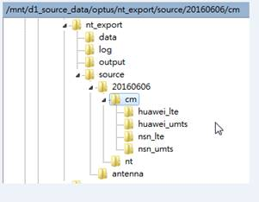
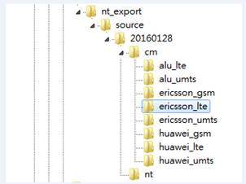
NT Process Step 1.
DP will collect all SIMS/SITEDB/MNIS (vendor NT csv/excel file) and CM file into our Server, General in AP server :
NT source folder structure
/data/nt_export/source/Date/cm
/data/nt_export/source/Date/nt
/opt/covmo/parser/nt/output/antenna (for NT_ANTENNA …. Some columns will reference from this ANTENNA_INFO.csv)
OPTUS
Etisalat

Slide 10
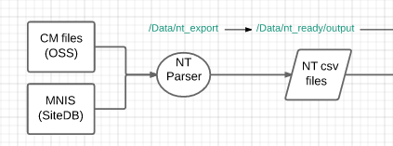
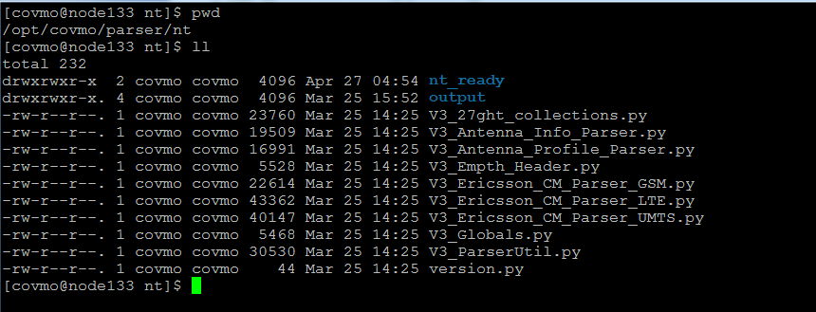
NT Process Step 2.
DP Call NT Parser for process those vendor’s data
V3_Antenna_Info_Parser.py
V3_Antenna_Profile_Parser.py
V3_Empth_Header.py
V3_Ericsson_CM_Parser_GSM.py
V3_Ericsson_CM_Parser_LTE.py
V3_Ericsson_CM_Parser_UMTS.py
V3_Huawei_CM_Parser_GSM.py
V3_Huawei_CM_Parser_LTE.py
V3_Huawei_CM_Parser_UMTS.py
…. Etc
/opt/covmo/parser/nt/

Slide 11
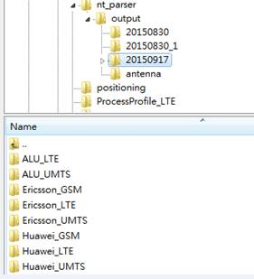
NT Process Step 3.
Parser will ouput each (vendor/Tech) parser’s output into /opt/covmo/parser/nt/output/[YYYYMMDD]

Slide 12
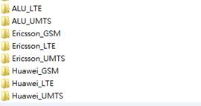
NT Process Step 4.
DP will copy those folder (without failed log) into /opt/covmo/parser/nt/nt_ready

Slide 13
NT Process Output CSVs
LTE | UMTS | GSM
(NT_PU.CSV) NT_CELL_LTE.CSV NT_ANTENNA_LTE.CSV NT_NBR_4_2_LTE.CSV NT_NBR_4_3_LTE.CSV NT_NBR_4_4_LTE.CSV NT_MME_LTE.CSV NT_TAC_CELL_LTE.CSV | NT_RNC.CSV NT_CELL.CSV NT_ANTENNA.CSV NT_NEIGHBOR.CSV NT_CELL_ATTRIBUTE.CSV | NT_BSC.CSV NT_CELL_GSM.CSV NT_ANTENNA_GSM.CSV NT_NEIGHBOR_GSM.CSV
Cell
Nbr 同一個system的table, 不同
Antenna 定位

Slide 14
NT Process Step 5
AP:application server
After nt_ready (ready files)
AP 1 (and 2) will start using /opt/covmo/parser/nt/nt_ready → copy to their won /opt/covmo/parser/nt/output/20160512
using /opt/covmo/parser/nt/output/20160512 to generate gt_nt_20160512 NT DB

Slide 15
NT Process Step 6 ( To be change )
Create NT DB
Create NT DB Schema (SP)
Load NT csv into NTDB
Generate Voronoi
NT checking & update & dump records (from SP)
if step 6 success, will backup db file into /opt/covmo/parser/nt/db_ready,
if step 5 fail, will using last /opt/covmo/parser/nt/db_ready

Slide 16
NT Process Step 7 ( To be change )
Gateway server cron job will copy /opt/covmo/parser/nt/db_ready from AP1 to them
Gateway server cron job @ closed time of 1, another cron job will copy /opt/covmo/parser/nt/nt_ready
Gateway server cron job will using db_ready for gt_nt_20160512 (new date NT DB )

Slide 17
Addition: Process ANTENNA_INFO
Antenna Profile
Antenna Atoll format
Antenna Info GT format \\Internal1\temp\training\Internal\
\\GHTDB02\Project3\CovMo\CovMo_NT\ANTENNA

Slide 18
ANTENNA_INFO
What need to know
Antenna Model
Antenna Type (Omni/Sector)
Antenna Gain
Antenna BeamWidth
dB3
dB6
Azimuth
Pattern

Slide 19
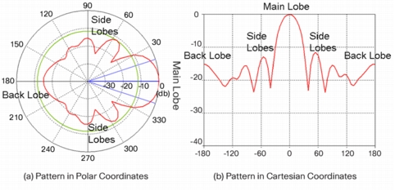
Antenna Model
Propagation Model for the signal strength (Gain loss)

Slide 20
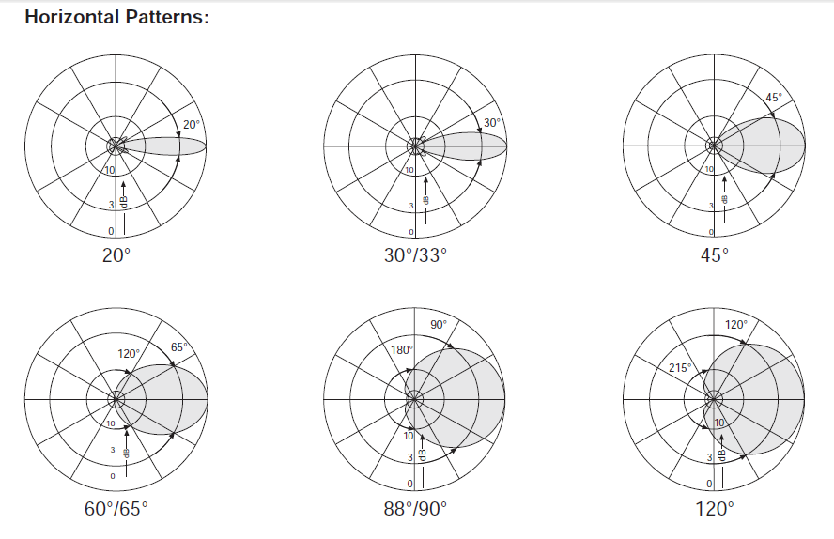
Antenna Pattern - Horizontal

Slide 21
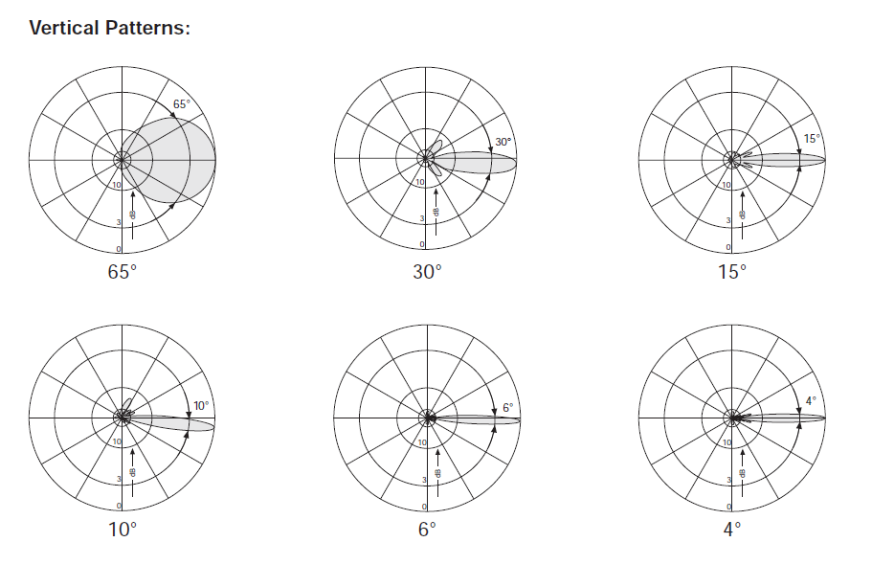
Antenna Pattern - Vertical

Slide 22
ANTENNA_INFO
\\internal1\temp\Candy\NT\ANTENNA_INFO.csv

Slide 23

Thank you! Questions & Comments
23
Notes:
23
in conclusion, CovMo supports you to have
Better network quality.
Better intelligence regarding how to improve network to recover most revenue
More precise femtocell deployment.
Less unnecessary micro cells.
And CovMo will be the key for your improving coverage, capacity, and /quality of the network.

Slide 25
File link
Antenna Info
\\internal1\temp\Candy\NT\ANTENNA_INFO.csv
Antenna Profile \\internal1\temp\Candy\NT\Antenna_Library\download_antenna
NT Rule definition
SIMS \\ghtdb02\project3\SingTel\NT\Data\NT_Source\SITE DATA\SIMS data ample.xlsx
NT Rule \\ghtdb02\project3\SingTel\NT\CovMo_NT_Rule_20160217.xlsx
CM \\ghtdb02\project3\SingTel\NT\Data\NT_Source\cm

Slide 26
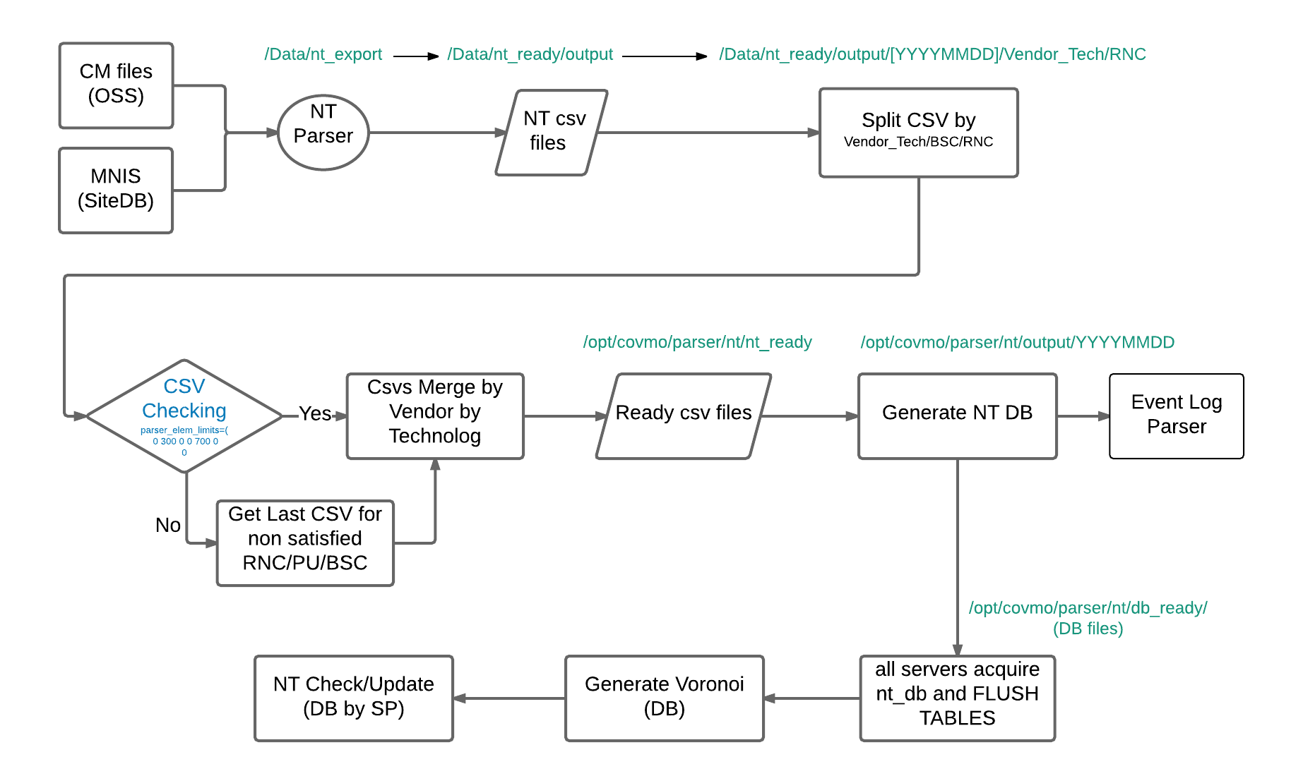
Advance ….

